Slide 1
OVERFLOW & GGNS-T1 Analysis of the NASA CRM WB configuration for DPW-VII
Ben Rider Boeing Commercial Airplane
Dmitry Kamenetskiy Boeing Research & Technology
Behzad Reza Ahrabi Boeing Research & Technology
Joshua Krakos Boeing Research & Technology

Slide 2
Outline
Flow Solvers and Grid Summary
OVERFLOW (NASA)
GGNS-T1 (Boeing)
Convergence History
Cases Analyzed
OVERFLOW
GGNS-T1
Results
Case 1: CRM Wing-Body Grid Convergence Study
Case 2: CRM Wing-Body Alpha Sweep
Case 3: CRM Wing-Body Reynolds Number Sweep At Constant CL
Case 4: CRM Wing-Body Alpha Sweep with Grid Adaptation
Conclusions

Slide 3
OVERFLOW: Solver, Grid and Computing Platform
OVERFLOW version 2.3e
Same setup as used for past workshops for consistency
2nd order central differencing
Central / Beam-Warming scalar pentadiagonal scheme (IRHS=0, ILHS=2)
SA turbulence model (SA-neg-noft2) with:
RC: rotation/curvature corrections
QCR: nonlinear stress model via QCR
fully turbulent boundary layer, free stream initial conditions
full N-S, exact wall distance calculation
Common Overset Grid
Provided by Committee
Utilized Ivy Bridge nodes with 2 ten-core processor per node
case | grid | points (M) | cores | sec/it | sec/it/grid | iterations | wall clock
T | Tiny | 5.72 M | 40 | 0.94 | 16.550e-8 | 20000 | 5.1 hrs
C | Coarse | 18.62 M | 40 | 1.95 | 10.450e-8 | 20000 | 10.5 hrs
M | Medium | 43.32 M | 120 | 1.60 | 3.703e-8 | 25000 | 10.9 hrs
F | Fine | 83.66 M | 220 | 2.10 | 2.511e-8 | 25000 | 14.3 hrs
X | Extra Fine | 143.47 M | 300 | 2.28 | 1.599e-8 | 30000 | 18.8 hrs
U | Ultra Fine | 226.59 M | 460 | 2.79 | 1.240e-8 | 35000 | 26.9 hrs

Slide 4
GGNS-T1: Solver, Grid and Computing Platform
GGNS-T1
Discretization
SU/PG(1)
Tetrahedral cells
piecewise-linear, globally continuous finite elements
Residual-based stabilization
Shock capturing/artificial dissipation by (Glasby et.al.[1])
Solver
RANS, steady-state (SA, SA-QCR2000, SARC-QCR2000 fully turbulent)
Fully coupled turbulence equations
Exact Jacobians (except SARC) with operator overloading
Pseudo-transient continuation to steady-state
Newton’s method
Parallel MPI implementation based on PETSc [2]
12 orders for the dual-volume weighted discrete residuals
10 orders for the adjoint linear system residual
Adaptation : EPIC [3]
Goal oriented (GO) “ε₁+ ε₂, multi-component” from [4]
400 cores x 24 hours for 24 solver/adaptation cycles
Includes primal and adjoint solves and grid adaptation times
EPIC Adapted Grids
Drag Adjoint Adaption
case | grid | points (M)
- | L0 – L13 | 0 –> 1.8 M
- | L14 – L16 | ~3.6 M
- | L17 | ~5.0 M
- | L18 - L20 | ~6.8 M
- | L21 | ~10.9 M
- | L22 – L24 | ~13.5 M

Slide 5
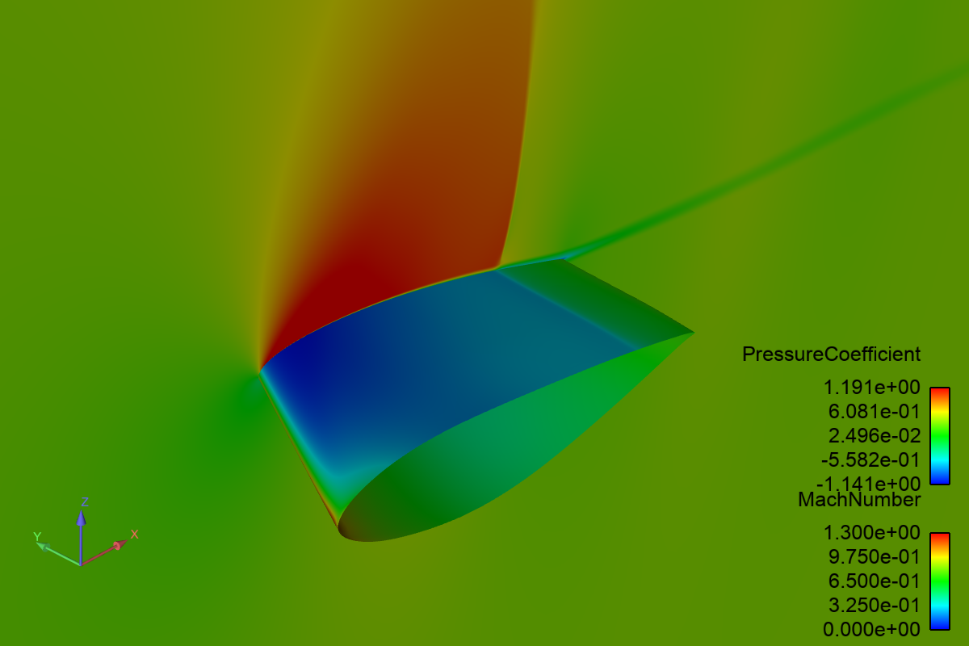
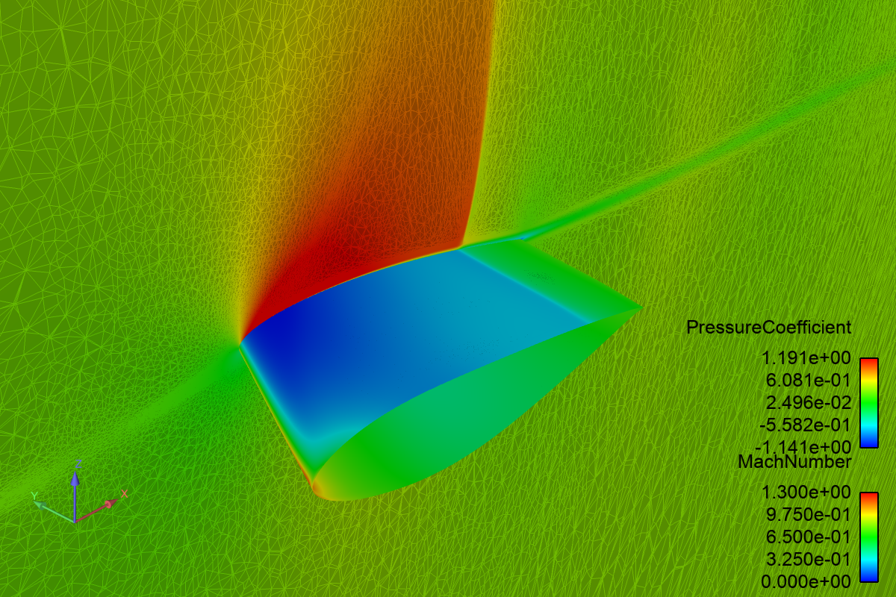
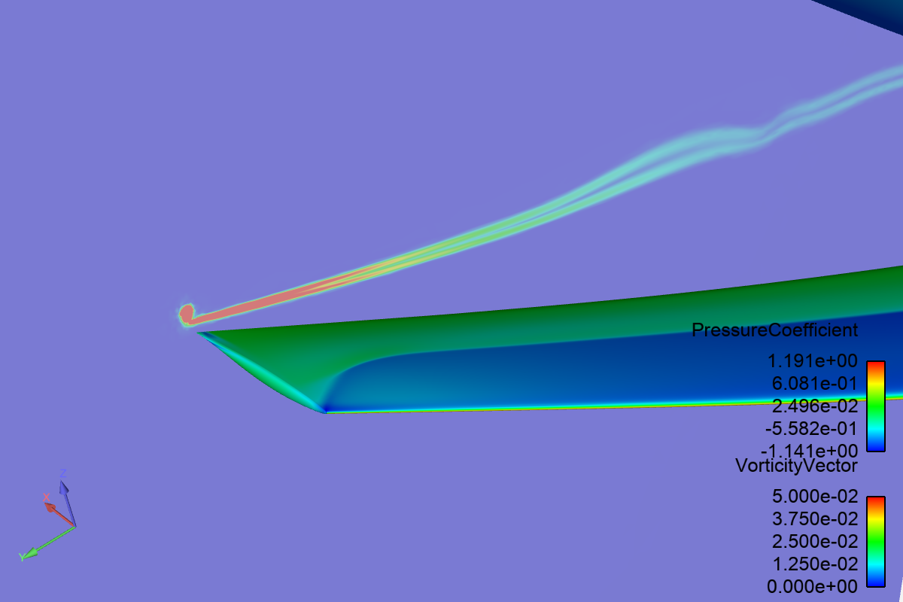
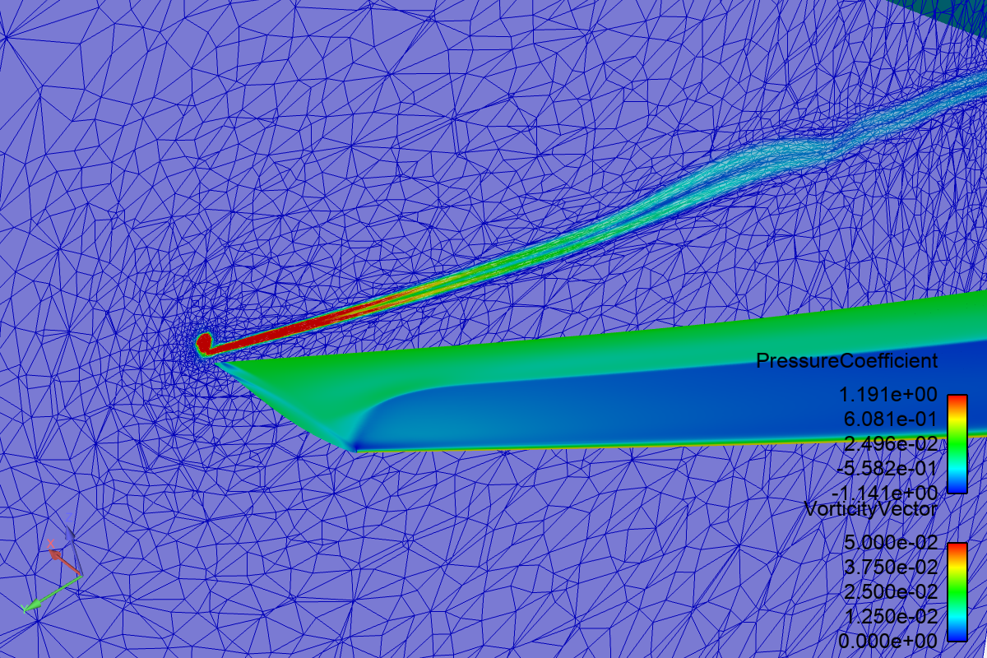
GGNS-T1/EPIC Grid Visualization

Slide 6
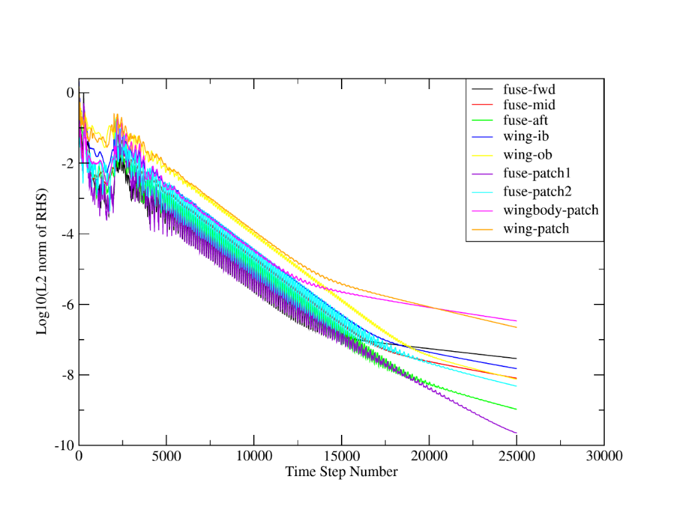
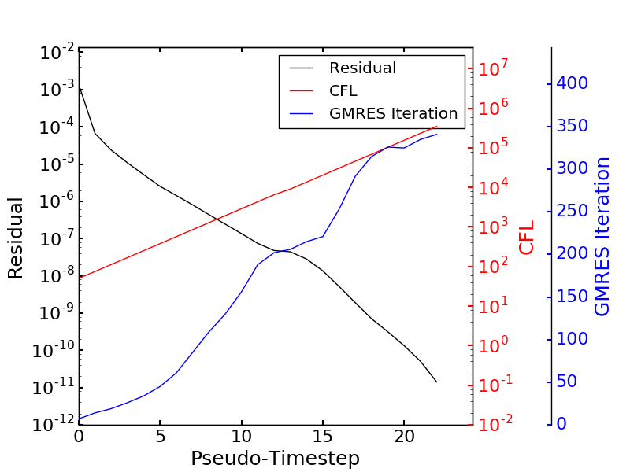
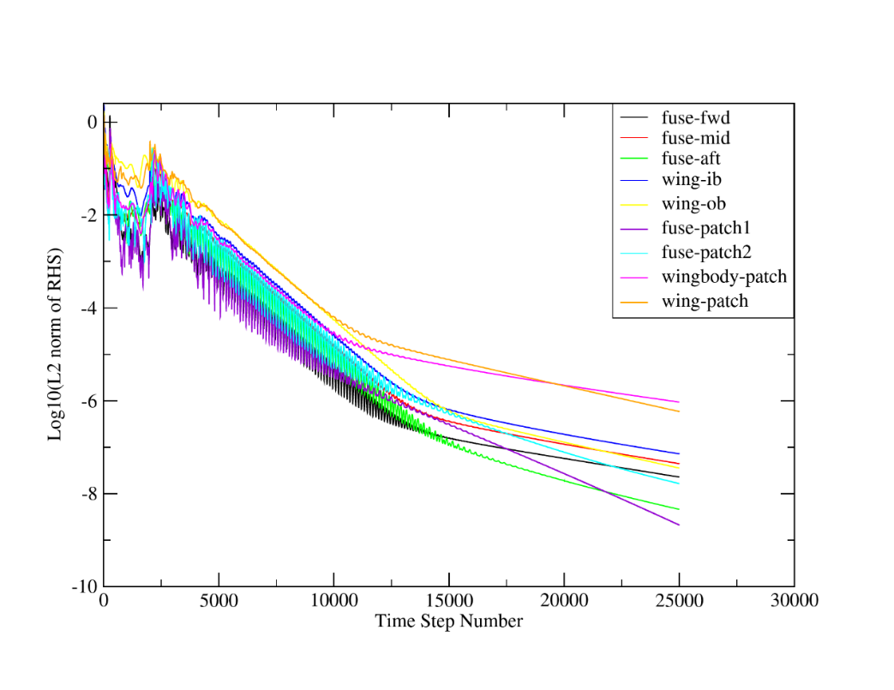
Convergence History: Residuals
Residuals for Mach 0.85, CL = 0.58
Medium Grid
OVERFLOW
Rey# 20M
GGNS-T1
(Final Grid)
Rey# 5M

Slide 7
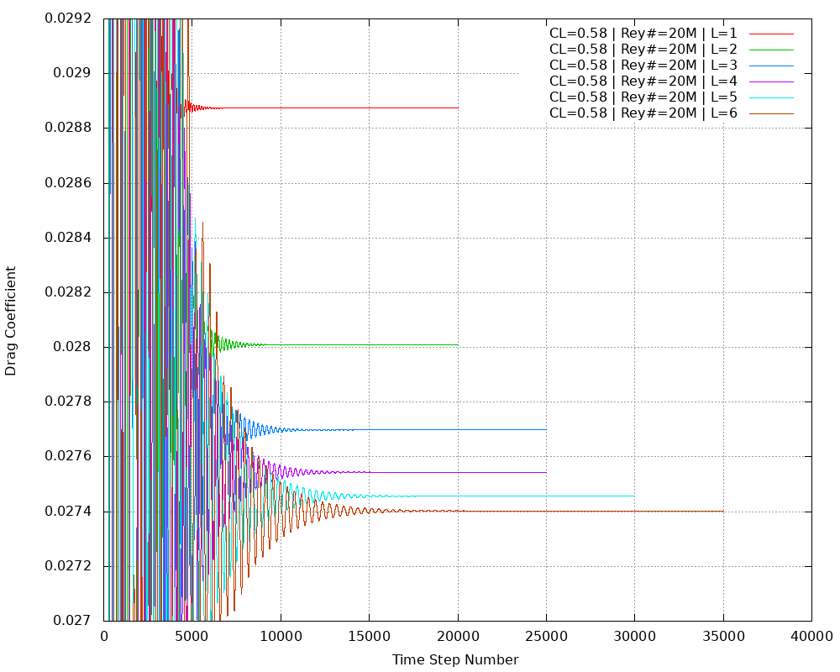
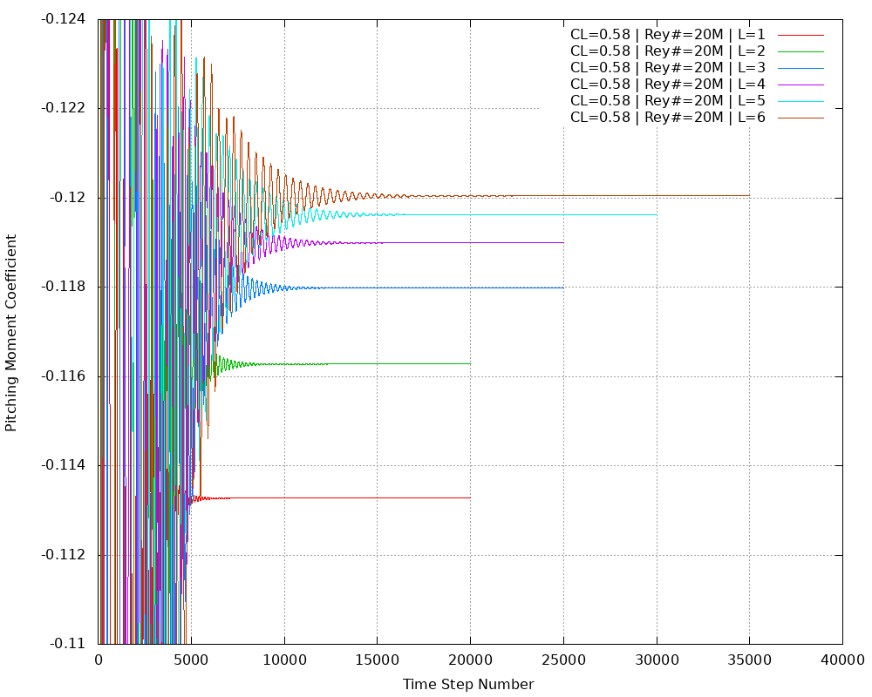
Convergence History: Force/Moment
Forces/Moments for Mach=0.85, CL=0.58
Drag Coefficient
Pitching Moment

Slide 8
Cases Analyzed
Case 1: Grid Convergence Study (CL=0.58) | OVERFLOW | GGNS-T1
Case 1a: Rey# 20M | X | X
Case 1b: Rey# 5M | X | X
Case 2: Alpha Sweep (Fixed Grid) | OVERFLOW | GGNS-T1
Case 2a: Rey# 20M | X | X
Case 2b: Rey# 5M | X | X
Case 3: Reynolds Number / Q Sweep | OVERFLOW | GGNS-T1
Case 3: CL=0.50 | X | X
Case 4: Alpha Sweep (Grid Adaptive) | OVERFLOW | GGNS-T1
Case 4a: Rey# 20M |  | X
Case 4b: Rey# 5M |  | X

Slide 9
Case 1
CRM Wing-Body Grid Convergence Study

Slide 10
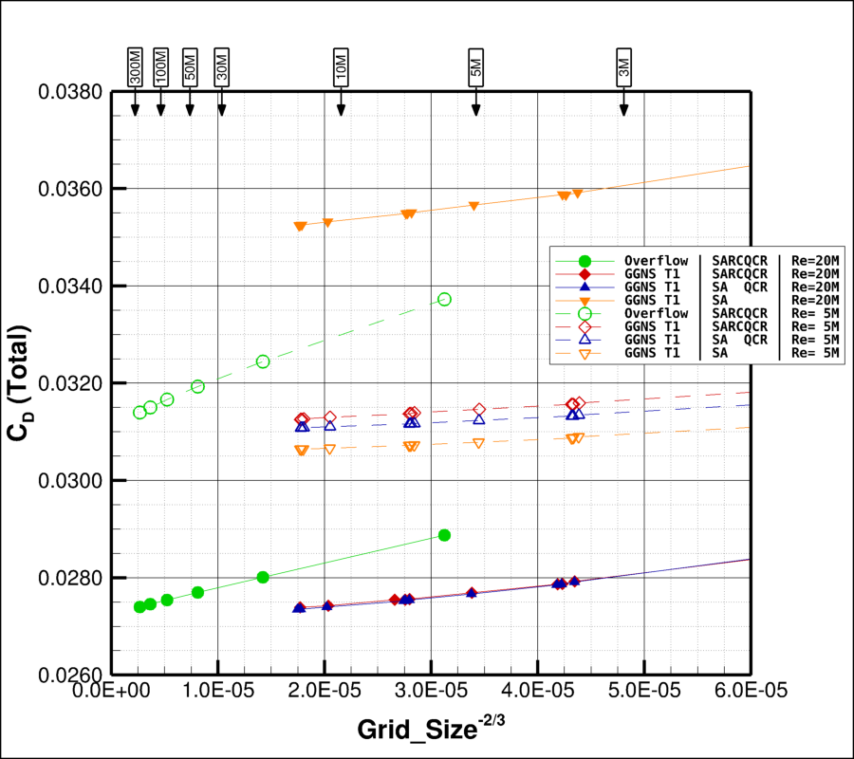
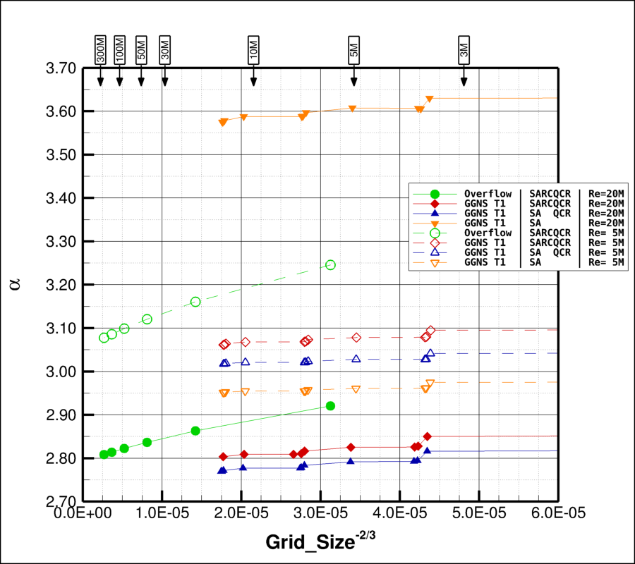
Case 1: CRM Wing-Body Grid Convergence Study
Case 1a: Mach=0.85, CL=0.58, Rey# 20M
Closed Symbols
Case 1b: Mach=0.85, CL=0.58, Rey# 5M
Open Symbols
Total Drag
Angle of Attack
0.1°
20 cnts
SA-QCR
← Increasing Grid Size
← Increasing Grid Size

Slide 11
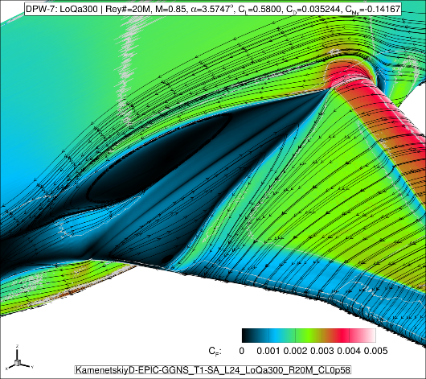
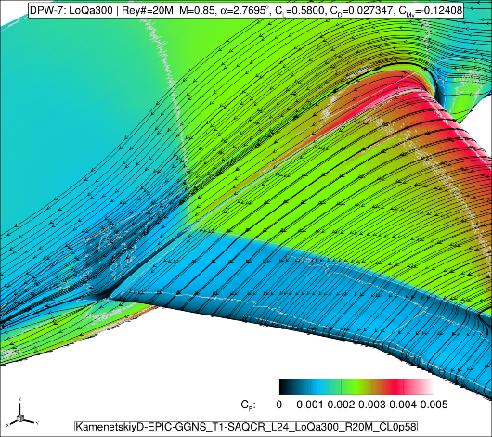
Case 1: CRM Wing-Body Grid Convergence Study
Case 1a: Mach=0.85, CL=0.58, Rey# 20M
Closed Symbols
Case 1b: Mach=0.85, CL=0.58, Rey# 5M
Open Symbols
spurious side-of-body
juncture separation!
Total Drag
SA (no QCR)
Angle of Attack
0.1°
Rey# 5M
Rey# 5M
20 cnts
Rey# 20M
Rey# 20M
SA-QCR
← Increasing Grid Size
← Increasing Grid Size

Slide 12
Case 1: CRM Wing-Body Grid Convergence Study
Case 1a: Mach=0.85, CL=0.58, Rey# 20M
Closed Symbols
Case 1b: Mach=0.85, CL=0.58, Rey# 5M
Open Symbols
spurious side-of-body
juncture separation!
SA (no QCR) will be
ignored on remainder
of Case 1 charts
Total Drag
SA (no QCR)
Angle of Attack
0.1°
Rey# 5M
Rey# 5M
20 cnts
Rey# 20M
Rey# 20M
SA-QCR
← Increasing Grid Size
← Increasing Grid Size

Slide 13
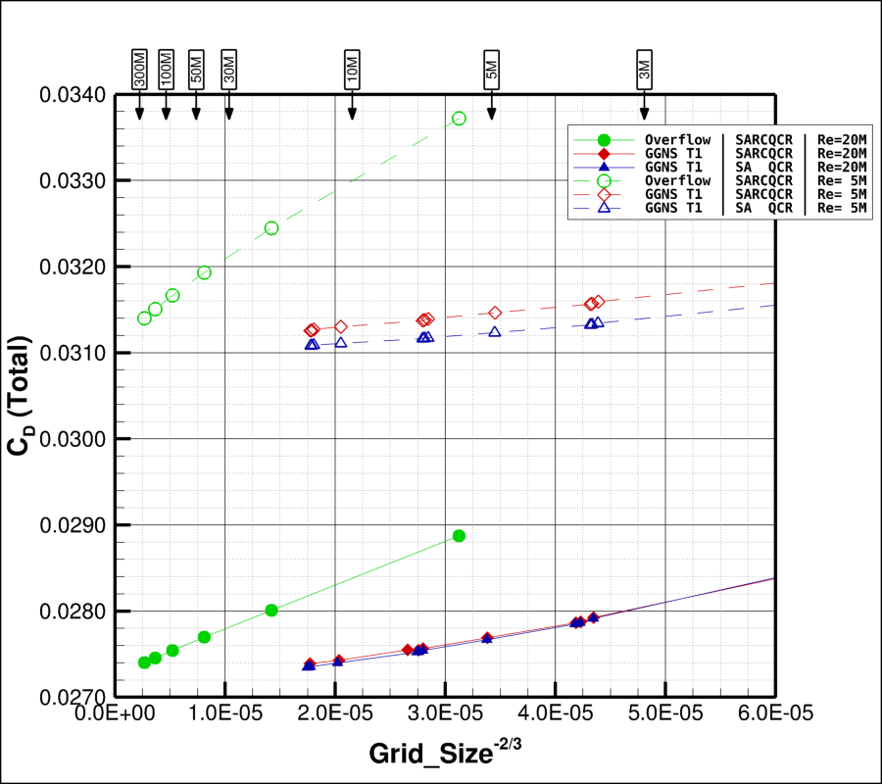
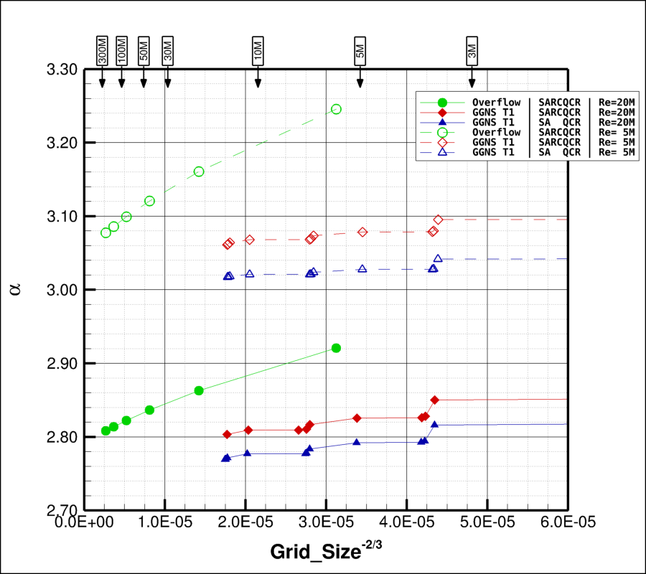
Case 1: CRM Wing-Body Grid Convergence Study
Case 1a: Mach=0.85, CL=0.58, Rey# 20M
Closed Symbols
Case 1b: Mach=0.85, CL=0.58, Rey# 5M
Open Symbols
Total Drag
Angle of Attack
0.1°
10 cnts
← Increasing Grid Size
← Increasing Grid Size

Slide 14
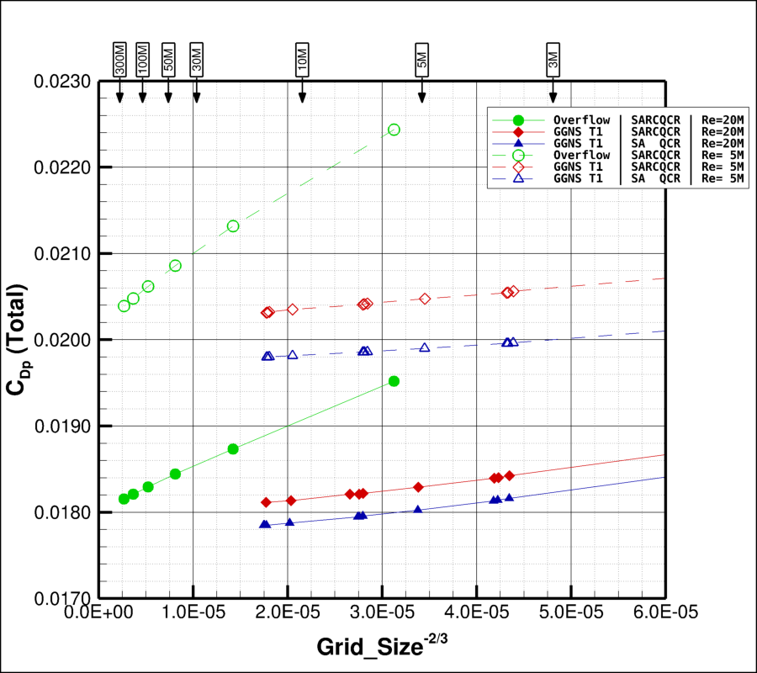
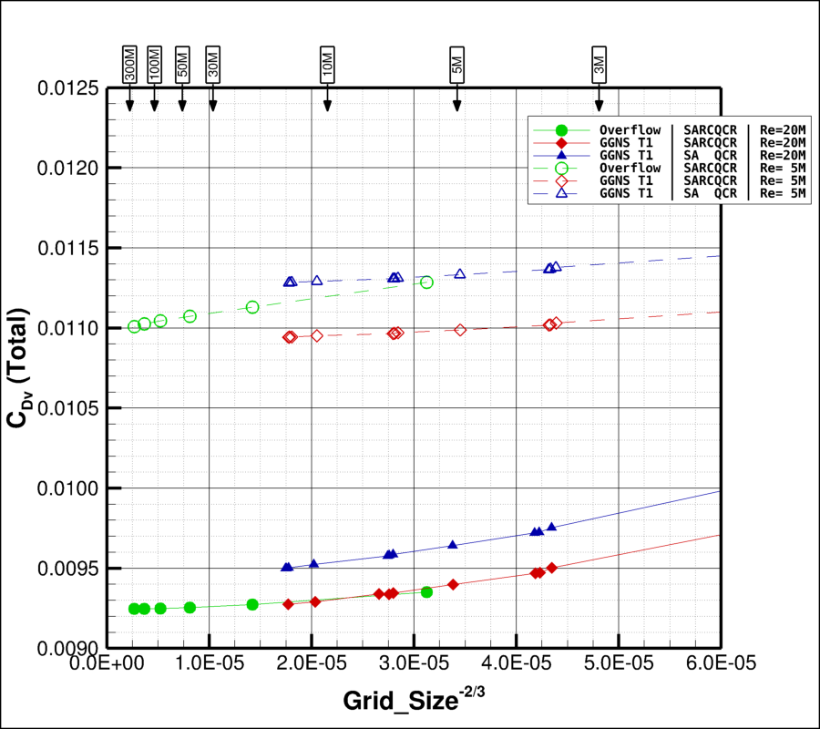
Case 1: CRM Wing-Body Grid Convergence Study
Case 1a: Mach=0.85, CL=0.58, Rey# 20M
Closed Symbols
Case 1b: Mach=0.85, CL=0.58, Rey# 5M
Open Symbols
Pressure Drag
Viscous Drag
10 cnts
5 cnts
← Increasing Grid Size
← Increasing Grid Size

Slide 15
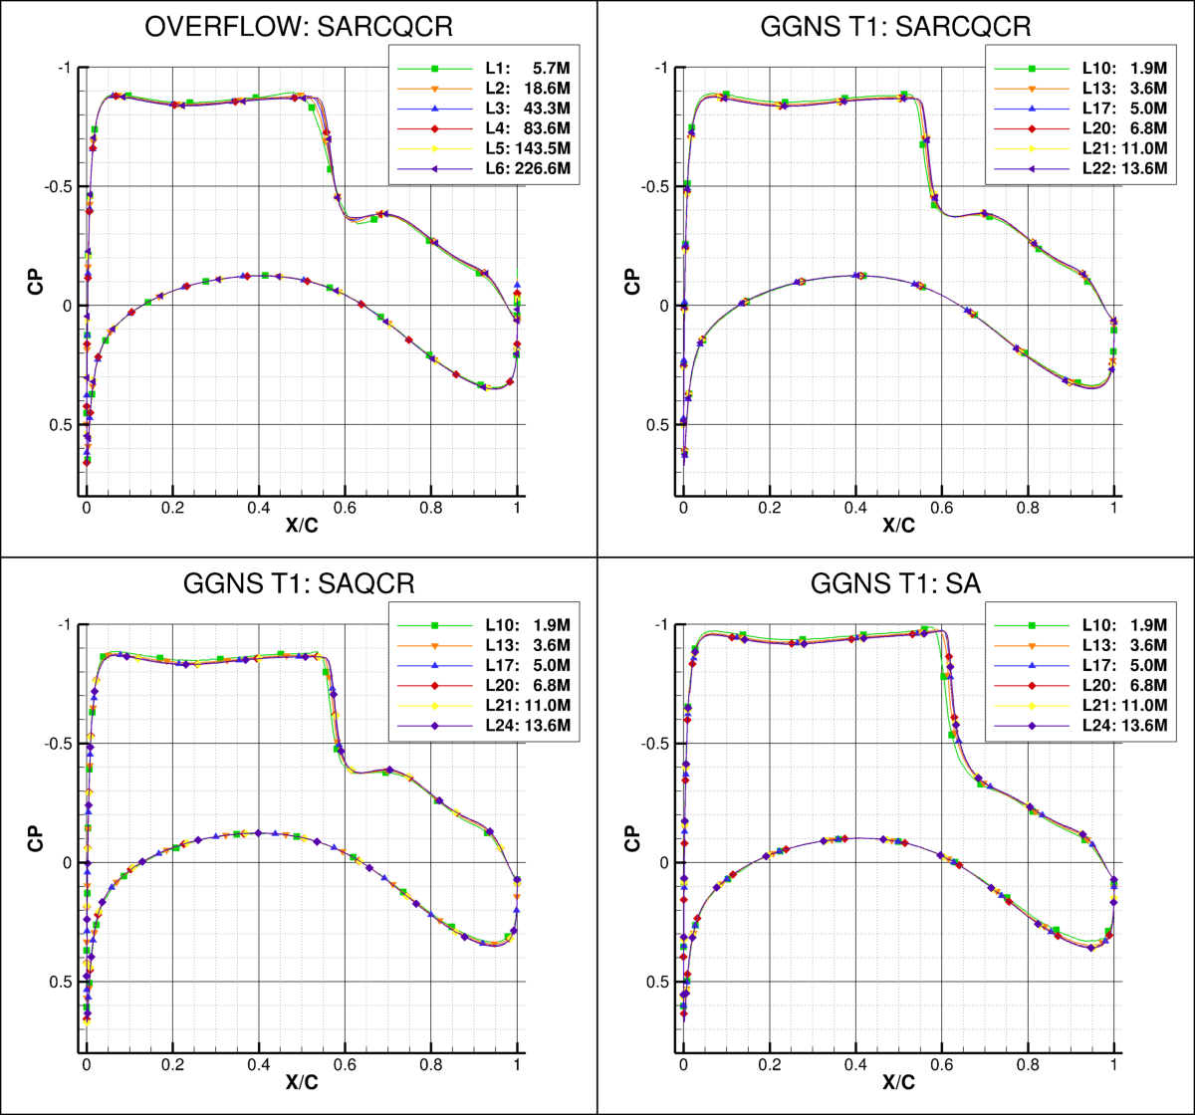

Case 1: CRM Wing-Body Grid Convergence Study
Case 1a: Mach=0.85, CL=0.58, Rey# 20M
Closed Symbols
Case 1b: Mach=0.85, CL=0.58, Rey# 5M
Open Symbols
Pressure Comparison (CL=0.58, Rey# 20M)
Section 12 – Eta = 0.7268
Pitching Moment
← Increasing Grid Size

Slide 16
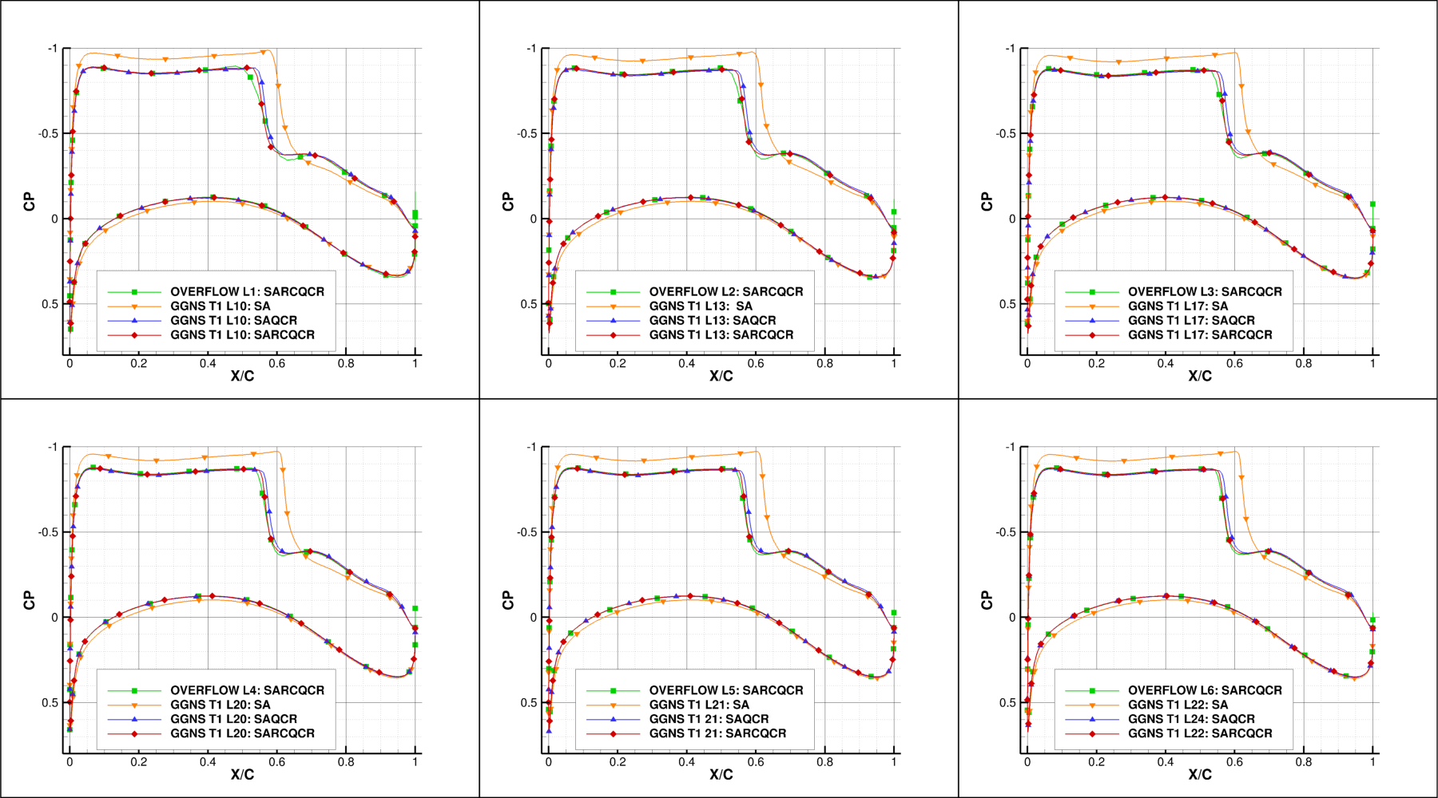
Case 1: CRM Wing-Body Grid Convergence Study
Pressure comparison: Section 12 – Eta = 0.7268
CL=0.58, Rey# 20M

Slide 17
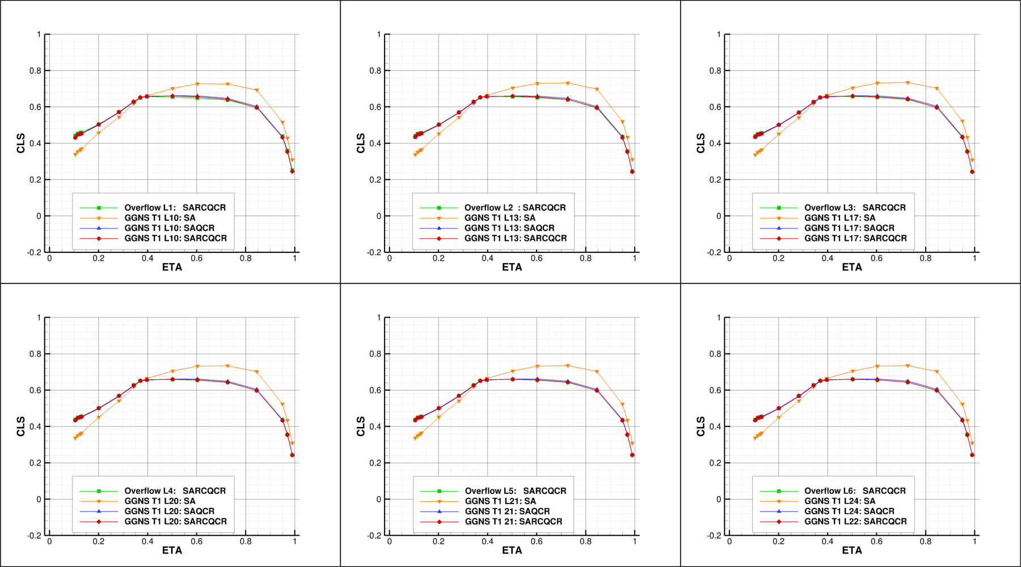
Case 1: CRM Wing-Body Grid Convergence Study
Spanload comparison
CL=0.58, Rey# 20M

Slide 18
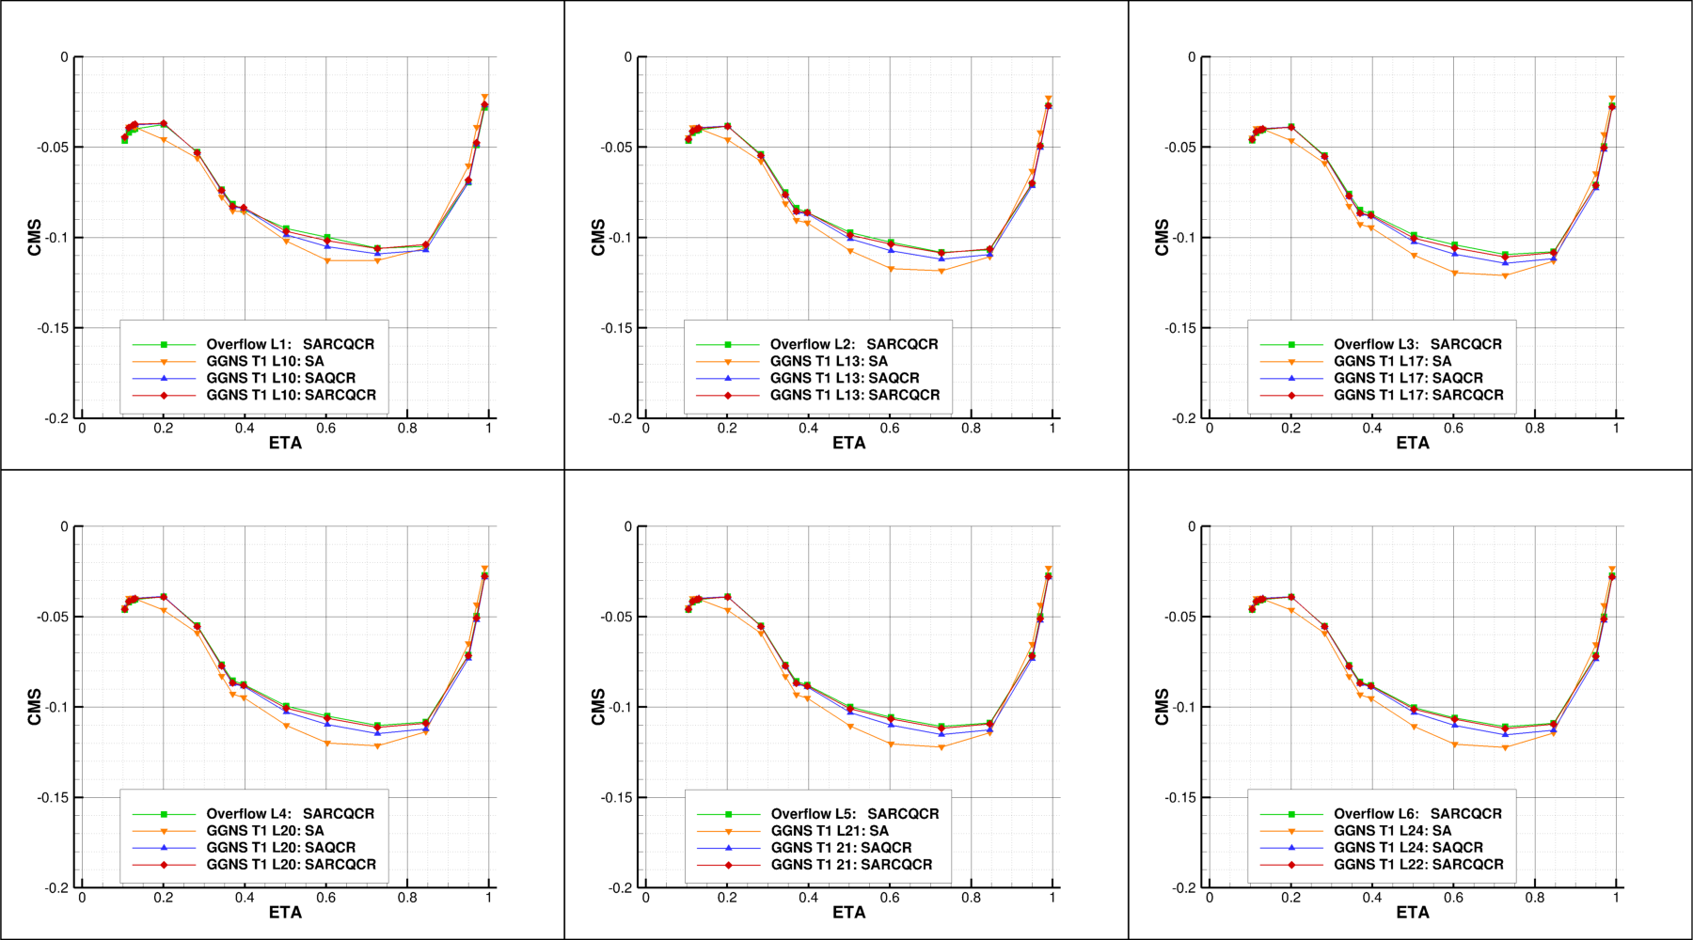
Case 1: CRM Wing-Body Grid Convergence Study
Sectional Moment comparison
CL=0.58, Rey# 20M

Slide 19
Case 2
CRM Wing-Body Alpha Sweep

Slide 20
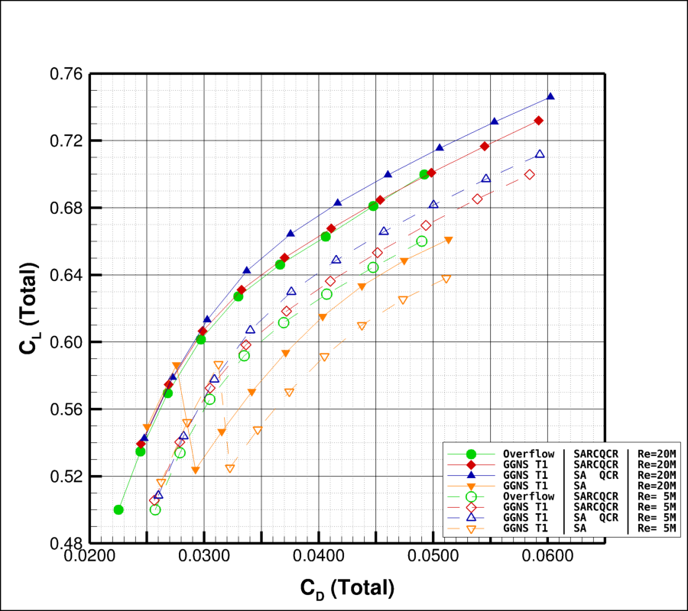
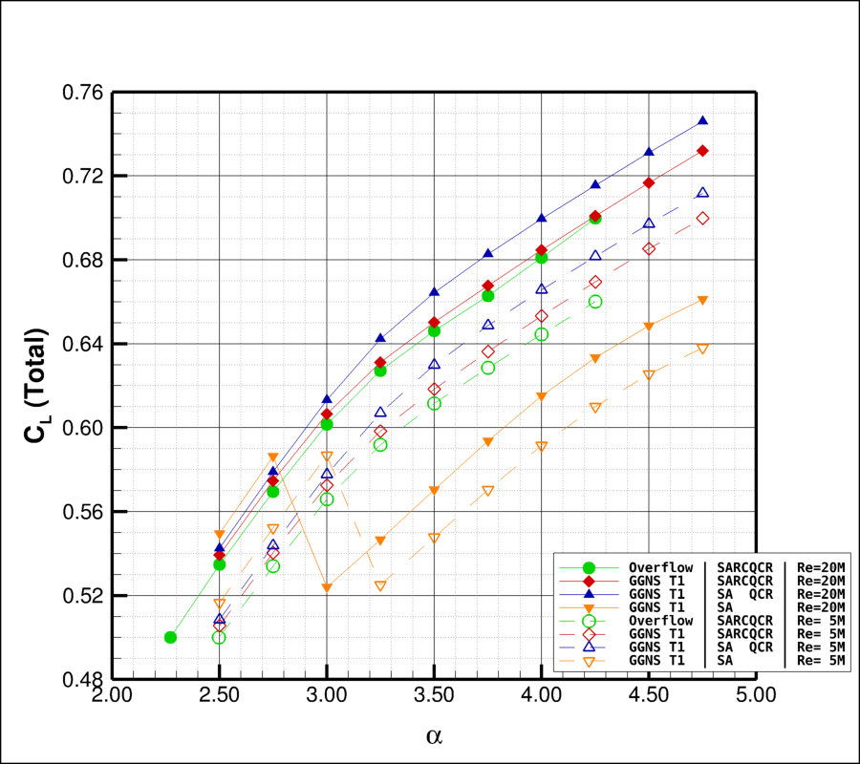
CRM Wing-Body Alpha Sweep
Case 2a: Mach=0.85, Rey# 20M, Alpha=[2.75° - 4.25° by 0.25°]
Closed Symbols
Case 2b: Mach=0.85, Rey# 5M, Alpha=[2.75° - 4.25° by 0.25°]
Open Symbols
Drag Polar
Lift Polar
50 cnts
0.5°

Slide 21
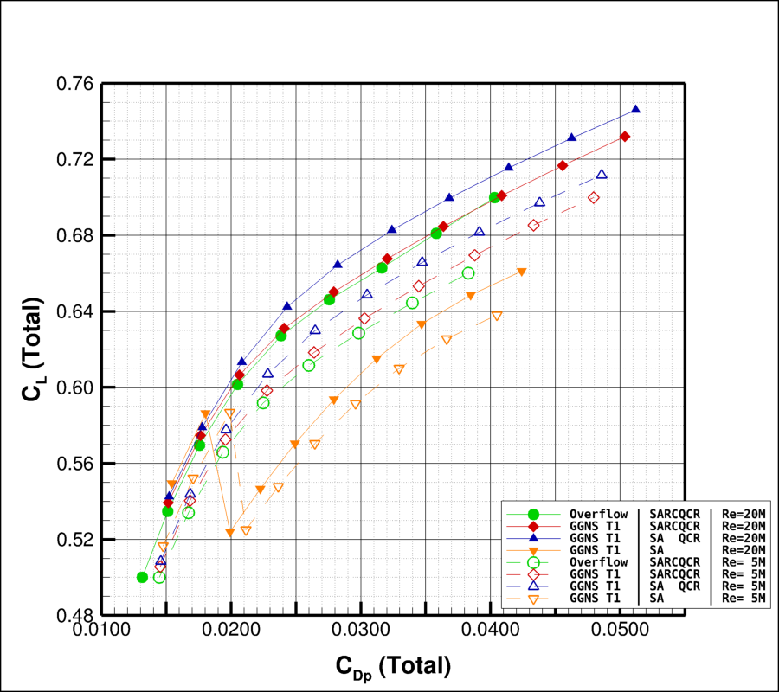
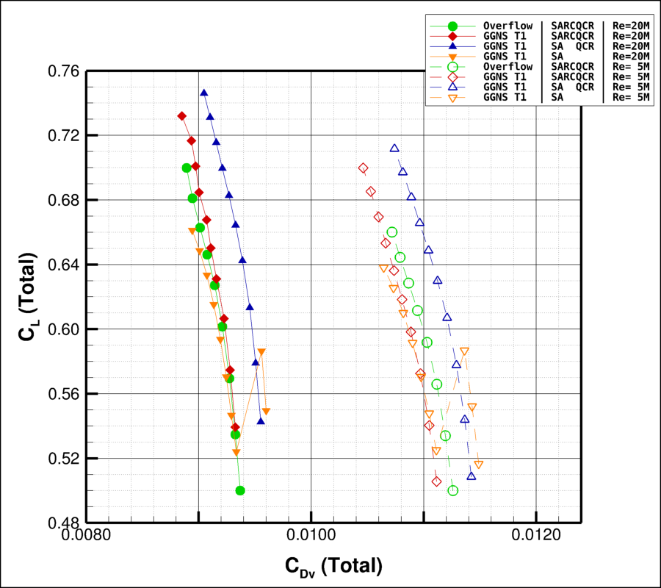
Case 2: CRM Wing-Body Alpha Sweep
Case 2a: Mach=0.85, Rey# 20M, Alpha=[2.75° - 4.25° by 0.25°]
Closed Symbols
Case 2b: Mach=0.85, Rey# 5M, Alpha=[2.75° - 4.25° by 0.25°]
Open Symbols
Pressure Drag Polar
Viscous Drag Polar
50 cnts
10 cnts

Slide 22
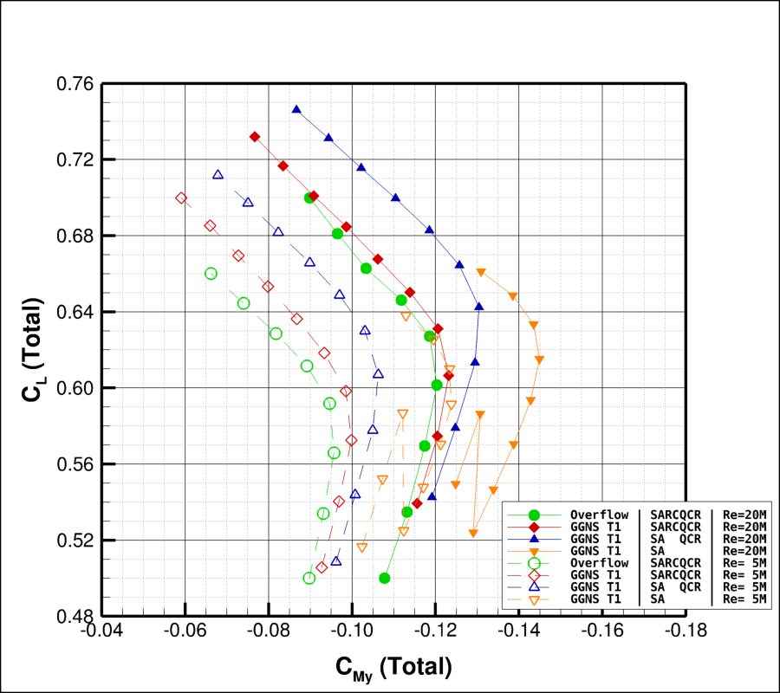
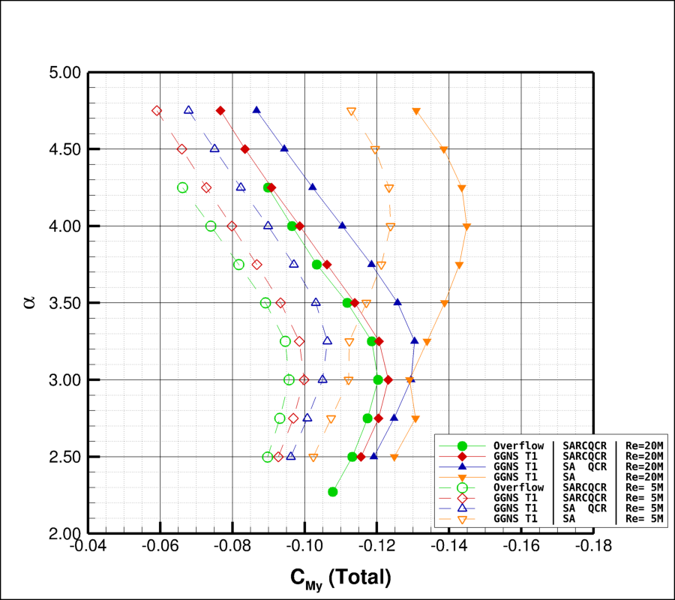
Case 2: CRM Wing-Body Alpha Sweep
Case 2a: Mach=0.85, Rey# 20M, Alpha=[2.75° - 4.25° by 0.25°]
Closed Symbols
Case 2b: Mach=0.85, Rey# 5M, Alpha=[2.75° - 4.25° by 0.25°]
Open Symbols
Pitching Moment vs. CL
Pitching Moment vs Alpha

Slide 23
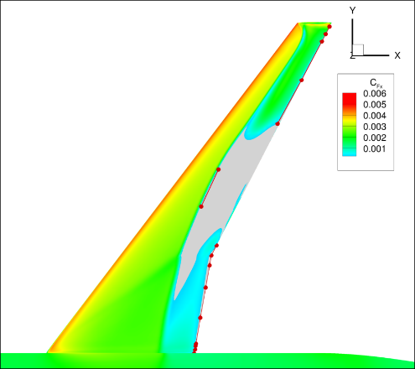
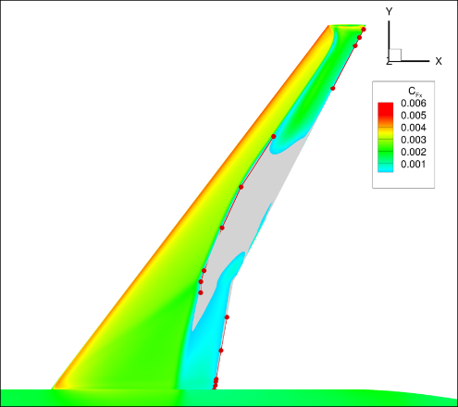
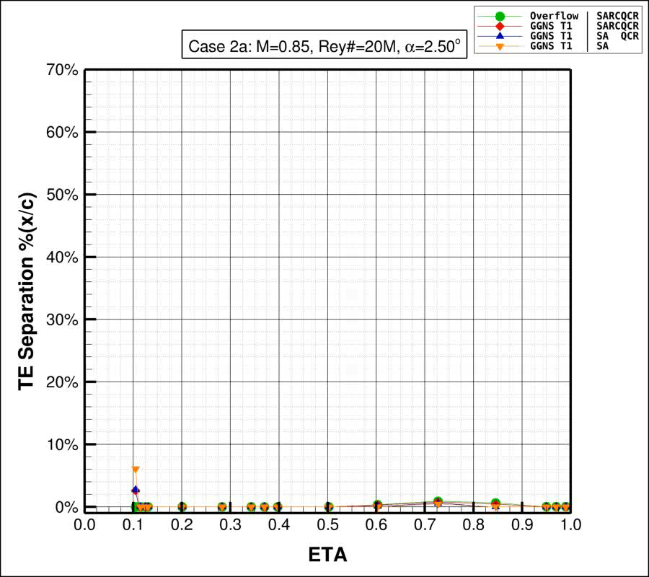
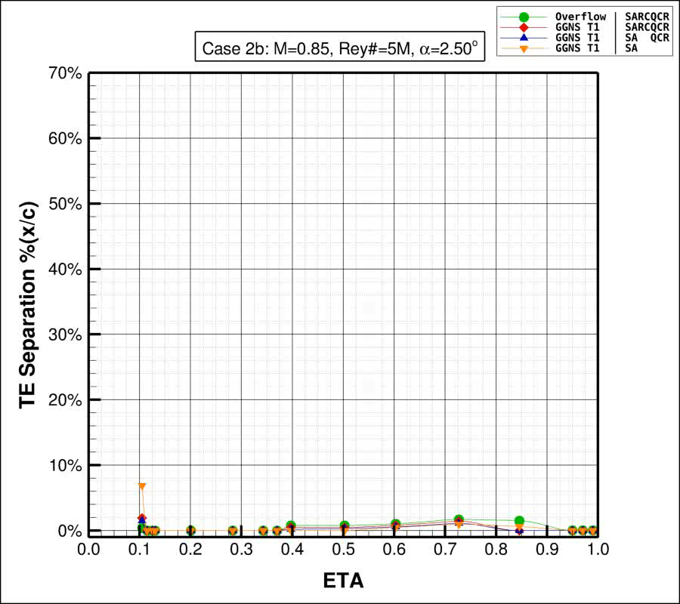
Case 2: CRM Wing-Body Alpha Sweep
Case 2a: Mach=0.85, Rey# 20M, Alpha=[2.75° - 4.25° by 0.25°]
Closed Symbols
Case 2b: Mach=0.85, Rey# 5M, Alpha=[2.75° - 4.25° by 0.25°]
Open Symbols
Rey# 20M: Trailing Edge Separation
Rey# 5M: Trailing Edge Separation
No TE
Separation

Slide 24
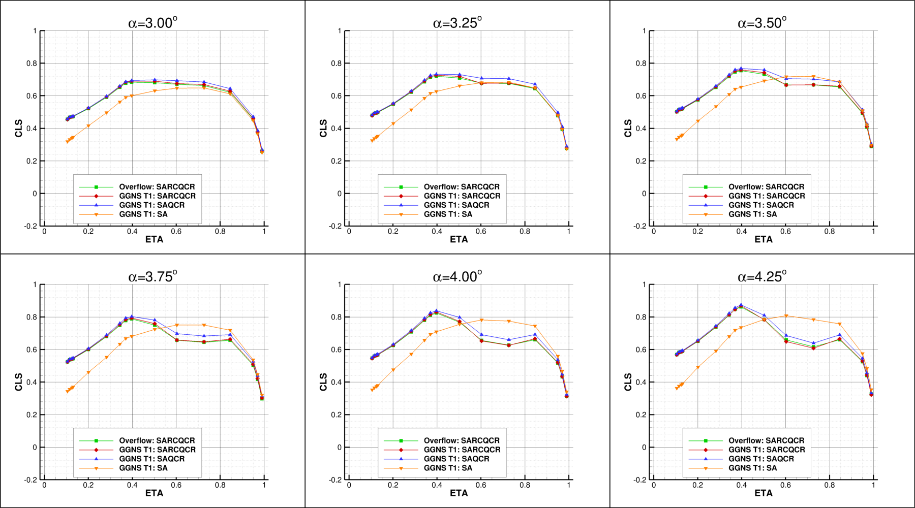
Case 2: CRM Wing-Body Alpha Sweep
Spanload comparison

Slide 25
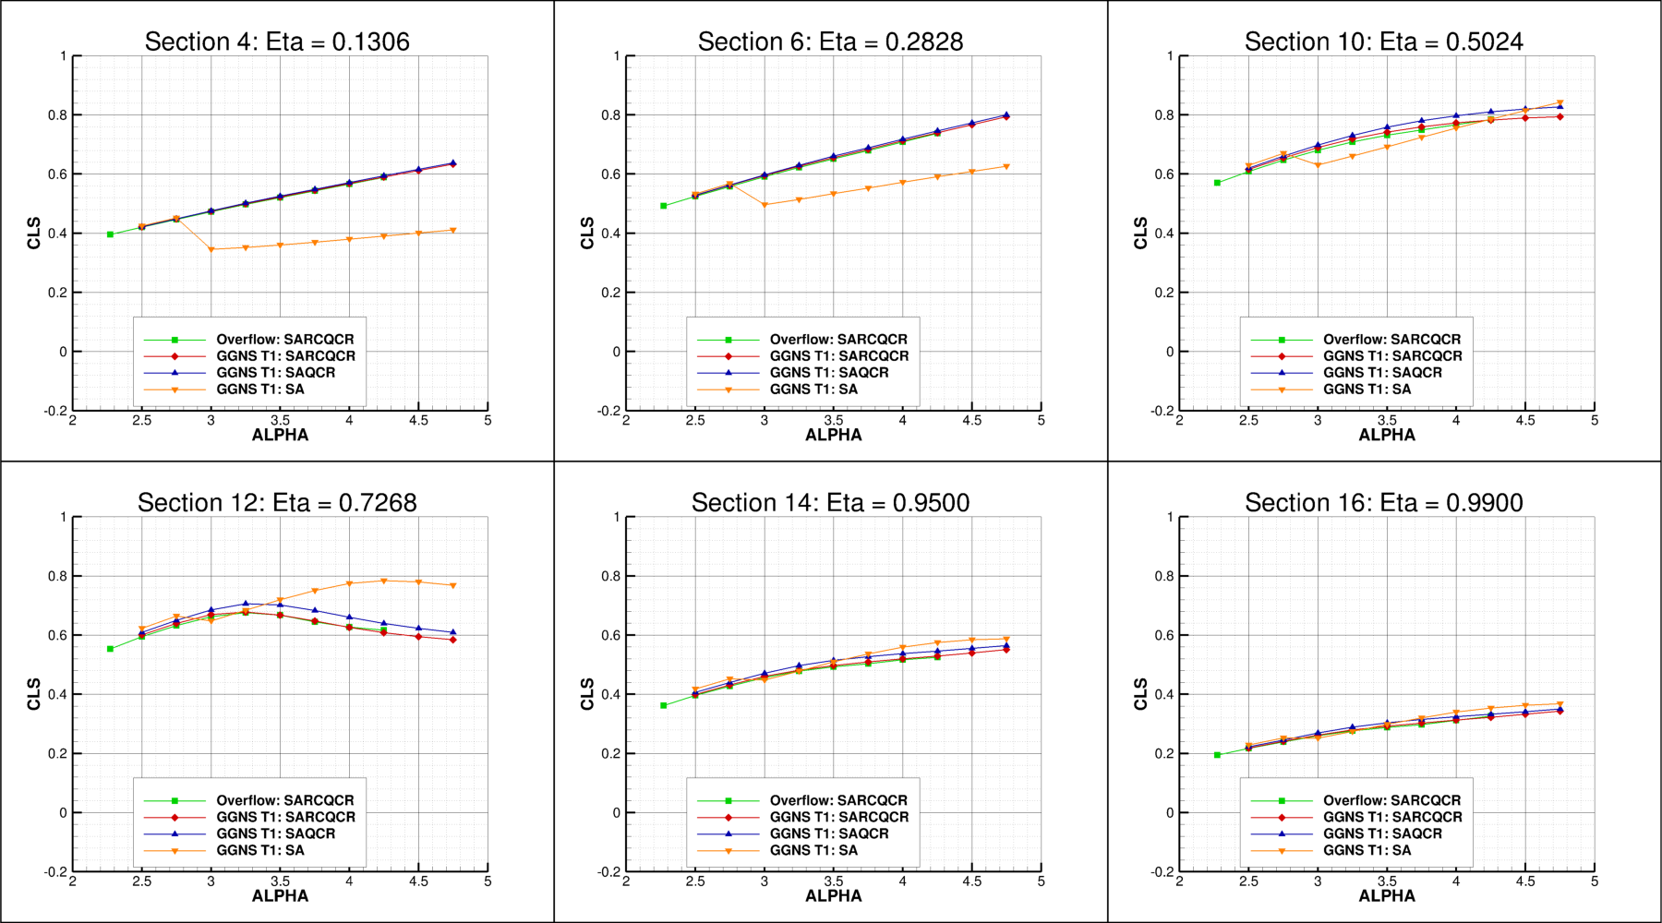
Case 2: CRM Wing-Body Alpha Sweep
Spanload comparison

Slide 26
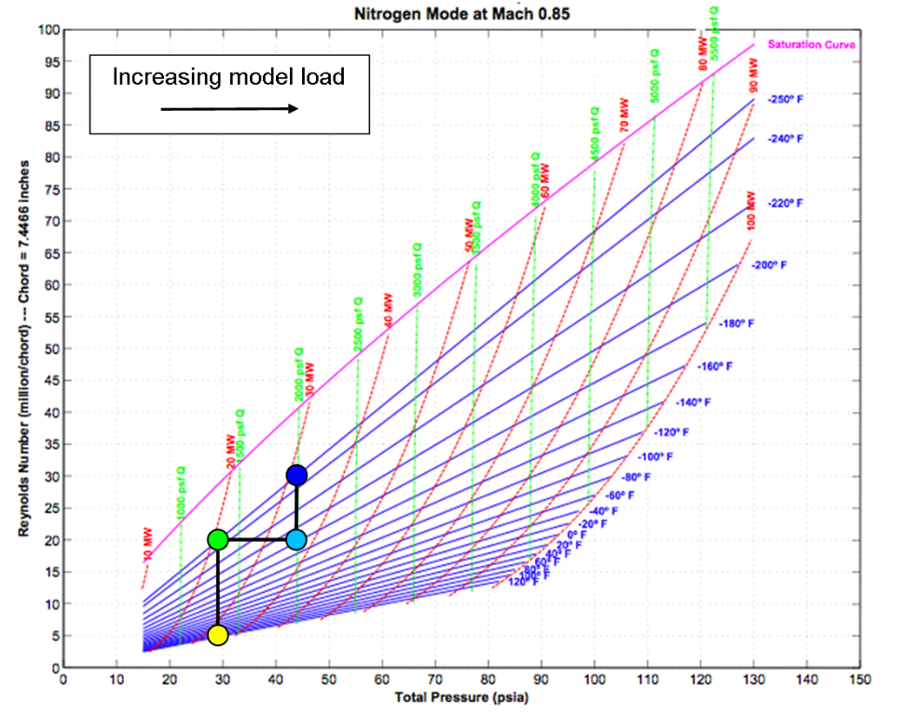
Case 3
Wing-Body Reynolds Number Sweep At Constant CL
CL=0.50, Mach=0.85, LoQ, Rey# 5M
CL=0.50, Mach=0.85, LoQ, Rey# 20M
CL=0.50, Mach=0.85, HiQ, Rey# 20M
CL=0.50, Mach=0.85, HiQ, Rey# 30M
AIAA-2008-6919, Vassberg, et al. “Development of a Common Research Model for Applied CFD Validation Studies”

Slide 27
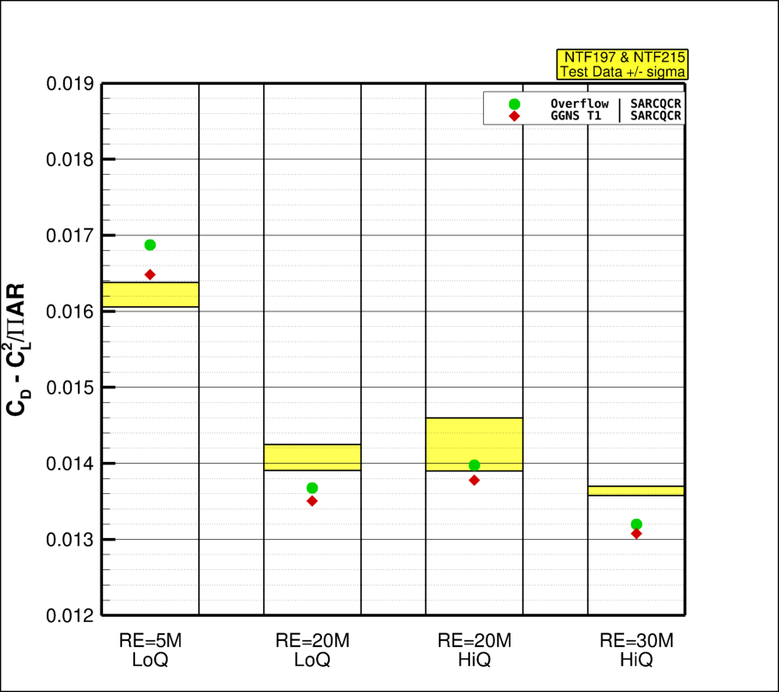
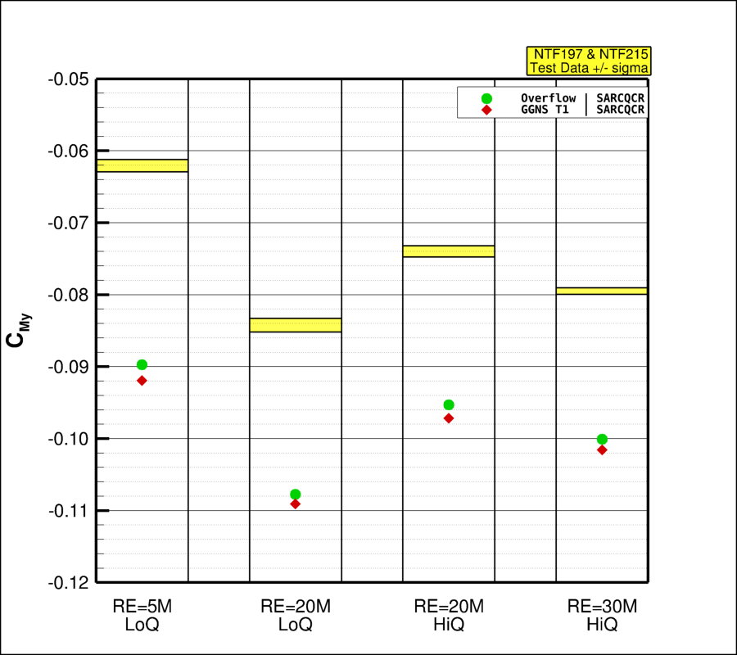
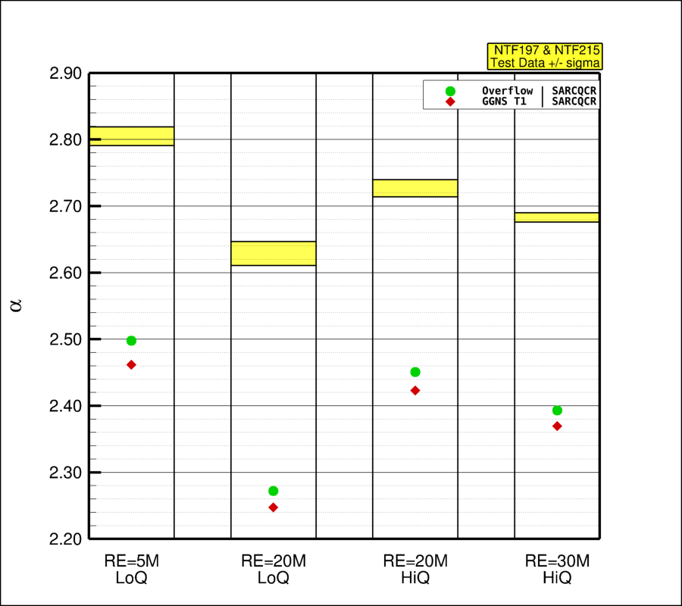
Case 3: Wing-Body Reynolds # Sweep At Constant CL=0.50
Case 3:
CL=0.50, Mach=0.85, LoQ, Rey# 5M
CL=0.50, Mach=0.85, LoQ, Rey# 20M
CL=0.50, Mach=0.85, HiQ, Rey# 20M
CL=0.50, Mach=0.85, HiQ, Rey# 30M
CDideal
Pitching Moment
Angle of Attack
NTF197 & NTF215
Test Data +/- sigma
AIAA 2012-0707, M. Rivers and C. Hunter “Support System Effects on the NASA Common Research Model”
AIAA 2012-3209, M. Rivers, C. Hunter, and R. Campbell “Further Investigation of the Support System Effects and Wing Twist on the NASA Common Research Model”
Adding the model support system to the CFD model changes wing, tail and aft body pressures and increases CM by ~0.03 and α by ~0.2° at CL = 0.50 for the Wing-Body-Tail configuration

Slide 28
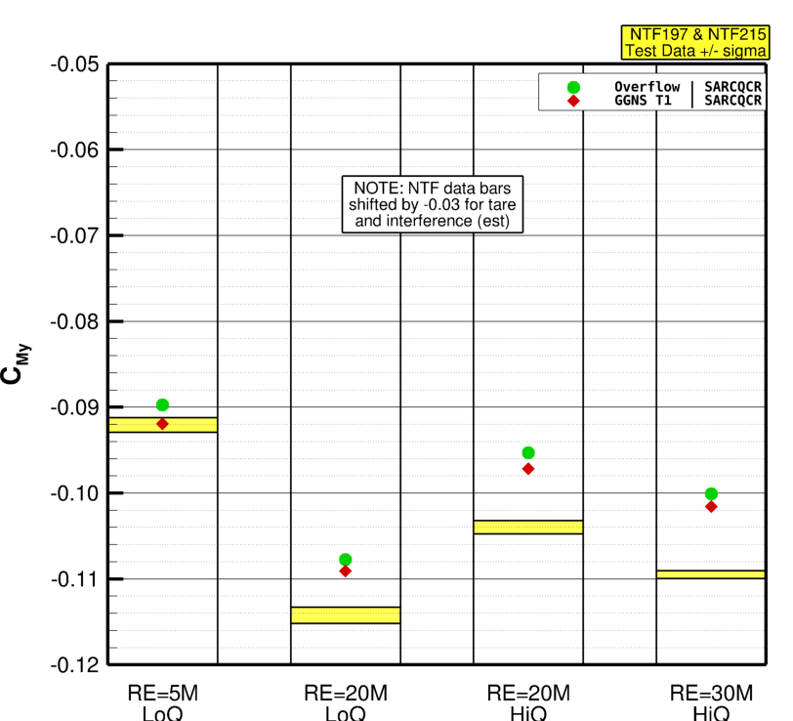
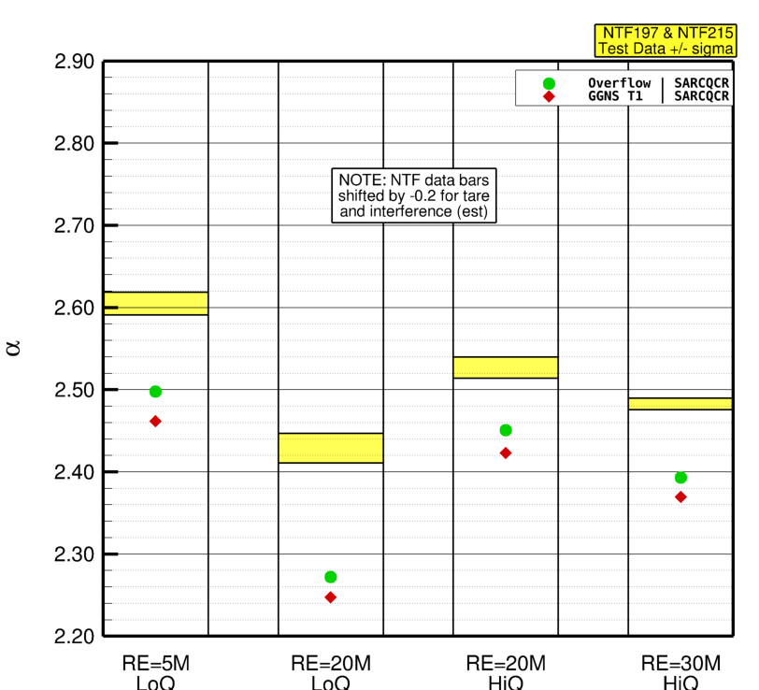
Case 3: Wing-Body Reynolds # Sweep At Constant CL=0.50
Case 3:
CL=0.50, Mach=0.85, LoQ, Rey# 5M
CL=0.50, Mach=0.85, LoQ, Rey# 20M
CL=0.50, Mach=0.85, HiQ, Rey# 20M
CL=0.50, Mach=0.85, HiQ, Rey# 30M
CDideal
Pitching Moment
Angle of Attack
NTF197 & NTF215
Test Data +/- sigma
AIAA 2012-0707, M. Rivers and C. Hunter “Support System Effects on the NASA Common Research Model”
AIAA 2012-3209, M. Rivers, C. Hunter, and R. Campbell “Further Investigation of the Support System Effects and Wing Twist on the NASA Common Research Model”
Adding the model support system to the CFD model changes wing, tail and aft body pressures and increases CM by ~0.03 and α by ~0.2° at CL = 0.50 for the Wing-Body-Tail configuration

Slide 29
Case 4
CRM Wing-Body Alpha Sweep with Grid Adaptation

Slide 30
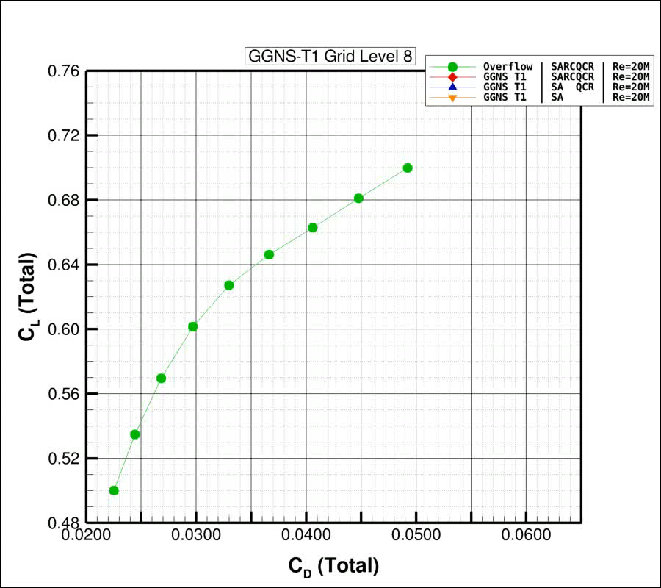
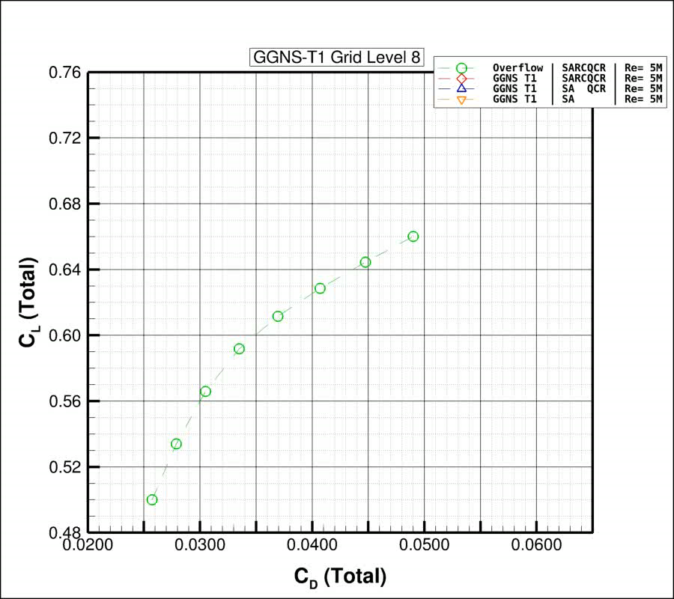
Case 4: CRM Wing-Body Alpha Sweep with Grid Adaptation
Case 4a: Mach=0.85, Rey# 20M, Alpha=[2.75° - 4.25° by 0.25°]
Closed Symbols
Case 4b: Mach=0.85, Rey# 5M, Alpha=[2.75° - 4.25° by 0.25°]
Open Symbols
Rey# 20M: Drag Polar
Rey# 5M: Drag Polar
50 cnts

Slide 31
Conclusions
Solver Comparison
The agreement between very different grid and solver strategies is very impressive
Turbulence Model
SA without QCR results in non-physical side-of-body separation
Consistent with previous DPW results
RC terms have an impact on forces/moments
Reduced lift and more positive pitching moment at constant alpha
Grid Adaption
GGNS-T1 with EPIC adaption based on the drag adjoint achieves results for Lift, Drag, and Pitching Moment comparable to OVERFLOW on the L6-UltraFine grid with an order of magnitude smaller grid!
Overflow L6: 226.6M
GGNS-T1 L24: ~13M
Alternative grid adaption based on flow features and/or the lift adjoint based metrics converge to the same result as the those shown here based on the drag adjoint.

Slide 33
References
[1] K R Holst, R S Glasby, J T Erwin, D L Stefanski, J G Coder, High-Order Shock Capturing Techniques using HPCMP CREATE-AV Kestrel, AIAA Scitech 2019 Forum, 2019
[2] https://petsc.org
[3] Todd Michal and Joshua Krakos, Anisotropic Mesh Adaptation Through Edge Primitive Operations, AIAA Paper 2012--159
[4] Dmitry S. Kamenetskiy, Joshua A. Krakos, Todd Michal, Francesco Clerici, Frédéric Alauzet, Adrien Loseille, Michael A. Park, Stephen L. Wood, Aravind Balan, Marshall C. Galbraith, Anisotropic Goal-Based Mesh Adaptation Metric Clarification and Development, AIAA paper 2022-1245

